Slide 1
WEB DESIGNING BCA-IV Sem By :- Dr. Pooja Nagpal Asst.Prof.(HIMT)Rohtak
Topic covered
Web Development: Introduction to HTML; Hypertext and HTML; HTML Document Features; HTML command Tags; Creating Links; Headers; Text styles; Text Structuring; Text colors and Background; Formatting text; Page layouts;Images; Ordered and Unordered lists; Inserting Graphics; Table Creation and Layouts; Frame Creation and Layouts; Working with Forms and Menus; Working with Radio Buttons; Check Boxes; Text Boxes; DHTML: Dynamic HTML, Features of DHTML,CSSP(cascading style sheet positioning) and JSSS(JavaScript assisted style sheet), Layers of netscape, The ID attributes, DHTML events.

Slide 2
Introduction to HTML
HTML is the standard markup language for creating Web pages.
HTML stands for Hyper Text Markup Language
HTML describes the structure of Web pages using markup
HTML elements are the building blocks of HTML pages
HTML elements are represented by tags
HTML tags label pieces of content such as "heading", "paragraph", "table", and so on
Browsers do not display the HTML tags, but use them to render the content of the page
Short for Hyper Text Markup Language, the authoring language used to create documents on the World Wide Web. HTML is similar to SGML, although it is not a strict subset. HTML defines the structure and layout of a Web document by using a variety of tags and attributes.

Slide 3
Features of HTML
HTML features which are useful right now include:
Web Workers: Certain web applications use heavy scripts to perform functions. Web Workers use separate background threads for processing and it does not affect the performance of a web page.
Video: You can embed video without third-party proprietary plug-ins or codec. Video becomes as easy as embedding an image.
Canvas: This feature allows a web developer to render graphics on the fly. As with video, there is no need for a plug in.
Application caches: Web pages will start storing more and more information locally on the visitor's computer. It works like cookies, but where cookies are small, the new feature allows for much larger files. Google Gears is an excellent example of this in action.

Slide 4
HTML Tags
HTML tags are element names surrounded by angle brackets:
HTML tags normally come in pairs like <p> and </p>
The first tag in a pair is the start tag, the second tag is the end tag
The end tag is written like the start tag, but with a forward slash inserted before the tag name
The purpose of a web browser (Chrome, IE, Firefox, Safari) is to read HTML documents and display them.
The browser does not display the HTML tags, but uses them to determine how to display the document.

Slide 5
HTML tags are the hidden keywords within a web page that define how your web browser must format and display the content. Most tags must have two parts, an opening and a closing part. For example, <html> is the opening tag and </html> is the closing tag.
HTML: The <html> tag tells the browser that this is an HTML document. The <html> tag represents the root of an HTML document. The <html> tag is the container for all other HTML elements.
HEAD: The <head> element is a container for all the head elements. The <head> element can include a title for the document, scripts, styles, meta information, and more.
TITLE: The <title> tag is required in all HTML documents and it defines the title of the document. The <title> element:
defines a title in the browser toolbar
provides a title for the page when it is added to favorites
Displays a title for the page in search-engine results.
BREAK: The <br> tag inserts a single line break. The <br> tag is an empty tag which means that it has no end tag.

Slide 6
BODY: The <body> tag defines the document's body. The <body> element contains all the contents of an HTML document, such as text, hyperlinks, images, tables, lists, etc.
CENTER: The <center> tag is used to center-align text.
EMPHASIZE: The <em> tag is a phrase tag. It renders as emphasized text.
FONT: The <font> tag specifies the font face, font size, and color of text.
FORM: The <form> tag is used to create an HTML form for user input.
INPUT: The <input> tag specifies an input field where the user can enter data. <input> elements are used within a <form> element to declare input controls that allow users to input data. An input field can vary in many ways, depending on the type attribute.
LIST: The <li> tag defines a list item. The <li> tag is used in ordered lists(<ol>), unordered lists (<ul>)
LINK: The <link> tag defines a link between a document and an external resource. The <link> tag is used to link to external style sheets.

Slide 7
PARAGRAPH: The <p> tag defines a paragraph. Browsers automatically add some space (margin) before and after each <p> element. The margins can be modified with CSS (with the margin properties).
HEADING: The <h1> to <h6> tags are used to define HTML headings. <h1> defines the most important heading. <h6> defines the least important heading.
TABLE: The <table> tag defines an HTML table. An HTML table consists of the <table> element and one or more <tr>, <th>, and <td> elements. The <tr> element defines a table row, the <th> element defines a table header, and the <td> element defines a table cell.
HORIZONTAL LINE: The <hr> tag defines a thematic break in an HTML page (e.g. a shift of topic). The <hr> element is used to separate content (or define a change) in an HTML page.
ITALICS: The <i> tag defines a part of text in an alternate voice or mood. The content of the <i> tag is usually displayed in italic. The <i> tag can be used to indicate a technical term, a phrase from another language, a thought, or a ship name, etc. Use the <i> element only when there is not a more appropriate semantic element.
IMAGE: The <img> tag defines an image in an HTML page. The <img> tag has two required attributes: src and alt.
SUBSCRIPT: The <sub> tag defines subscript text. Subscript text appears half a character below the normal line, and is sometimes rendered in a smaller font. Subscript text can be used for chemical formulas, like H₂O.
SUPERSCRIPT: The <sup> tag defines superscript text. Superscript text appears half a character above the normal line, and is sometimes rendered in a smaller font. Superscript text can be used for footnotes, like WWW.

Slide 8
Getting Started With HTML
Creating The HTML <head> Element
When creating an HTML document, one of the first things you will create is the <head> element. This contains metadata (or data about the HTML document). This includes information such as the character set, document title, document styles, scripts, etc.
Example:
<title>This is our page title</title>
This title will be displayed in the browser tab. It’s also what will be indexed as the title for the page when the search engine bots crawl your website.

Slide 9
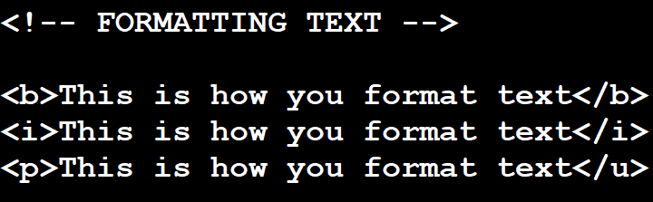
Formatting Text in HTML
Using bold: <b>He is a boy</b> comes out as He is a boy
Using italics: <i>He is a boy</i> comes out as He is a boy
Underlining text: <u>He is a boy</u> comes out as He is a boy. It’s worth noting that the <u> tag was deprecated in HTML 4.01

Slide 10
Ordered and Unordered Lists
Sooner or later you will have to create lists. Lists could be ordered (i.e. numbered) or unordered (i.e. unnumbered).
Here is an example of an ordered list:
Item 1
Item 2
Item 3
Here is how to create it:
<ol>
<li>Item 1
</li> <li>Item 2
</li> <li>Item 3
</li> </ol>

Slide 11
Here is an example of an unordered list:
Item 1
Item 2
Item 3
Here is how to create it:
<ul> <li>Item 1
</li> <li>Item 2
</li> <li>Item 3
</li> </ul>
If it is not already obvious. Here’s a breakdown:
The <li> tag is used to indicate each item on the list. When making a list, you can use the <ol> tag to indicate an ordered list (“o” = ordered and “l” = list) or the <ul> tag to indicate an unordered list (“u” = unordered and “l” = list). Got the gist?

Slide 12
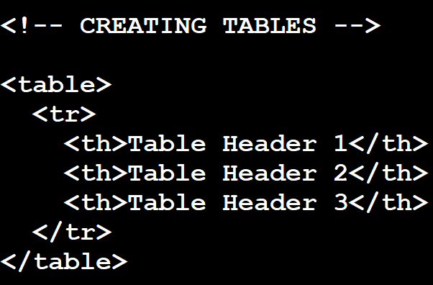
Creating Tables
As you get deeper into HTML, you will want to learn various ways to present information in a more organized way. One such way is through the use of tables.
Tables are created with the <table> tag. Each header in a table is specified with the <th> (“table header”) tag while each row is specified with the <tr> (“table row”) tag. The table data is then indicated with the <td> tag.

Slide 13
Using Comments in HTML
When doing any form of coding, it is important to learn how to include comments in your code. Comments are used to make your code more organized. You can include a reminder to yourself or a note to others to make things easier.
Initially, it might not seem important, but when you start writing hundreds or thousands of lines of code, and when things seem to start to get complicated, comments will come in handy.
Comments won’t be shown to the viewer by the browser. Remember that they can be seen in the source code.
Comments can also be used anywhere in the code. They won’t change the function of your code in any way.
You can include a comment by opening a bracket, including a double hyphen, adding your comment, including another double hyphen and then closing your bracket.
Example:
<!-- This is a comment used to indicate information I want to remember, or that I want others to take note of, when looki

Slide 14
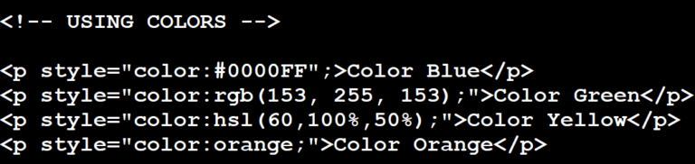
Using Colors in HTML
Sooner or later, you will want to use colors to indicate certain elements of your HTML document. This can be done in three main ways: with the HEX value, with the RGB value or with the name of the color.
Using color in HTML is usually done with the style attribute. We use the HTML color name (in this case “orange” – which we highlighted in the code by italicizing it) to ask that the text is highlighted in the orange color. Obviously, this is only feasible for texts for which you know the color names and can be difficult for certain color shades that can be easily done with the HEX code or RGB value. Regardless, you can find a list of 140 HTML color names compiled by HTML Color Codes.

Slide 15
Checkboxes
HTML checkboxes are simple fields that can be toggled on or off with a mouse click. A checkbox can have only one value — for example, "yes" or "true".
These fields are great for allowing the user to specify a single item of data — for example, whether they want to receive your newsletter or not, or to indicate that they have read your terms and conditions.
The checkbox field takes the format:
<input type="checkbox" name="xxxx" value="xxxx" checked="checked">
HTML checkbox example:
Would you like to be added to our mailing list? <input type="checkbox" name="mailing_list" value="yes" checked="checked"> Yes

Slide 16
Radio buttons
Radio buttons are similar to checkboxes, except that only one radio button in a group can be selected at any one time. (As with checkboxes, a radio button group is a collection of radio buttons with the same name attribute.)
Radio buttons are useful for getting a user to pick from a choice of options. (If you have a lot of options, consider using a menu instead.) The radio button tag has the same attributes as the checkbox element:
<input type="radio" name="xxxx" value="xxxx" checked="checked">
The name attribute is the name of the field (for example, "favourite_colour"). You can specify multiple radio boxes all with the same name, in which case they will belong to the same group. Only one radio button in the group can be selected at any one time.

Slide 17
DHTML Introduction
DHTML stands for Dynamic HTML, it is totally different from HTML. The browsers which support the dynamic HTML are some of the versions of Netscape Navigator and Internet Explorer of version higher than 4.0. The DHTML is based on the properties of the HTML, javascript, CSS, and DOM (Document Object Model which is used to access individual elements of a document) which helps in making dynamic content. It is the combination of HTML, CSS, JS, and DOM. The DHTML make use of Dynamic object model to make changes in settings and also in properties and methods. It also makes uses of Scripting and it is also part of earlier computing trends.
DHTML allows different scripting languages in a web page to change their variables, which enhance the effects, looks and many others functions after the whole page have been fully loaded or under a view process, or otherwise static HTML pages on the same. But in true ways, there is noting that as dynamic in DHTML, there is only the enclosing of different technologies like CSS, HTML, JS, DOM, and different sets of static languages which make it as dynamic.

Slide 18
HTML: HTML stands for Hypertext Markup Language and it is a client-side markup language. It is used to build the block of web pages.
Javascript: It is a Client-side Scripting language. Javascript is supported by most of the browser, also have cookies collection to determine the user needs.
CSS: The abbrevation of CSS is Cascading Style Sheet. It helps in the styling of the web pages and helps in designing of the pages. The CSS rules for DHTML will be modified at different levels using JS with event handlers which adds a significant amount of dynamism with very little code
DOM: It is known as a Document Object Model which act as the weakest links in it. The only defect in it is that most of the browser does not support DOM. It is a way to manipulate the static contents.

Slide 19
Features of DHTML
Following are the some major key features of DHTML:
Tags and their properties can be changed using DHTML.
It is used for real-time positioning.
Dynamic fonts can be generated using DHTML.
It is also used for data binding.
It makes a webpage dynamic and be used to create animations, games, applications along with providing new ways of navigating through websites.
The functionality of a webpage is enhanced due to the usage of low-bandwidth effect by DHTML.
DHTML also facilitates the use of methods, events, properties, and codes.

Slide 20
Difference between HTML and DHTML:
HTML is a markup language while DHTML is a collection of technologies.
HTML is used to create static webpages while DHTML is capable of creating dynamic webpages.
DHTML is used to create animations and dynamic menus but HTML not used.
HTML sites are slow upon client-side technologies whereas DHTML sites are comparatively faster.
Web pages created using HTML are rather simple and have no styling as it uses only one language whereas DHTML uses HTML, CSS, and Javascript which results in a much better and way more presentable webpage.
HTML cannot be used as server side code but DHTML used as server side code.
DHTML needs database connectivity but not in case of HTML.
Files in HTML are stored using .htm or .html extension while DHTML uses .dhtm extension.
HTML requires no processing from the browser but DHTML does.

